Slide 1
CIAM Project Updates
18th October 2024

Slide 2

COX - CIAM Project Status
ENGAGEMENT STATUS OVERVIEW
Overall Project Status
Data Engineering Milestones Status
Dashboards Designing Milestones Status
High Risk Challenges and Constraints
Tableau Access & S3 connectivity – WIP ( Manual approach to connect S3 but session disconnect in 8 Hrs.)
AWS complete data set access for eClerx Team – Pending
Excel operation limitation in Cox environment – Delay in data validation
DATA STAGING LAYER
BIZ. INTELLIGENCE LAYER
COX SUPPORT REQUIRED
3
3
Data Staging Goals & Discovery
Integrated Market Database
Solution Testing & Production Go Live
Solution Testing & Production Go Live
Create Profile/Account Fact Tables
Designing Wireframes/Mock Ups
Create Transaction Fact Tables
Stakeholder Validation & Review
Original ETA – 04th Nov’24
Tentative ETA – 6th Dec’24
Original ETA – 04th Nov’24
Tentative ETA – 6th Dec’24
Uploading Fact Tables to Sandbox
Design basis the Fact Tables Data
Tableau Connectivity to Sandbox
Review/Validation of Fact Tables
Validation of Data Metrics/Attributes
Data Access & Validation Completion
Create ETL Pipelines for Fact Tables
Integrate with the ETL pipelines
Access to the AWS Glue ETL Service
Ingesting Larger dataset into Tables
Validation with Larger Data ETL
Access to the Larger Data set

Slide 3
Project Status & Milestones – Data Engineering Track
Data Engineering |  | Progress | Risk Level | Complete Week | Dependencies & Challenges
Activity 1 – Create Fact Tables in Athena [Test/Sample]
 | Account Fact Table & Profile Fact Table |  |  | WE 9th September | Correct Filtering of Data & Field Level Data Validation
 | Transaction Fact Octa Table & Transaction Fact Adobe Table |  |  | WE 16th September
Activity 2 – Upload Fact Tables in S3 - CIAM_DATAMODEL [Test files]
 | Upload Fact Tables to S3 Bucket Storage |  |  | WE 23rd September | Data Transformation & Validation using AWS Quicksights
 | Validation and Transformation of Activity Fact Tables |  |  | Ongoing
Create Partition & Load - External Table in AWS Athena
 | Loading Incremental Data into the External Tables |  |  | WE 25th October | Access may take upto 2-3 weeks may delay these activities
 | Complete data update in all Fact Tables |  |  | WE 25th October
Create Data ETL Pipeline in AWS Glue
 | Create IAM Role for AWS Glue |  |  | WE 29st November | Dependency on Previous Tasks, AWS Glue Access may delay the Timelines
 | AWS Glue Crawler for Data Schema & Metadata Tables |  |  | WE 29st November
Data & Pipeline Testing & Production Deployment |  |  |  | WE 6st December | TBD
Complete
Low
Complete
Low
Complete
Low
WIP
Low
Not started
High
Not started
High
Not started
High
Not started
High
Not started
Medium

Slide 4
Project Status & Milestones – BI & Reporting Track
BI & Reporting Track |  | Progress | Risk Level | Complete Week | Dependencies & Challenges
Activity 1 –Wire Frame/Mock up Design for the Problem Statement
 | Design Mock up Wireframe for Business Agreement |  |  | WE 16th September | Design Validation & Agreement on the Final Wireframe
 | Iterative on the Agreed Design and Functionality |  |  | WE 23rd September
Activity 2 – Map/validate Columns to the Data Model (Fact Tables)
 | Upload Account Fact Table & Profile Fact Table |  |  | WE 18th October | Data Mapping/Validation to Design Wireframe & Transformation Assessment Dashboard development depend up on access to S3 from Tableau , which is pending further delays may shift ETAs
 | Transaction Fact Octa Table & Transaction Fact Adobe Table |  |  | WE 18th October
Demo & Iterate on the Agreed Design with Actual Data on Tableau
 | Integrate with Data Ingestion through ETL Pieplines |  |  | WE 15st November | Tableau & ETL Implementation & Completion by the Data Team
 | Data Tarnsformation & Design/Report Validation |  |  | WE 15st November
Dashboards Development & Getting Ready for Production
 | Creation of Profile & Activity Dashboards |  |  | WE 29th November | Previous Tasks and Validation & Sign off by the Business Teams
 | Testing of the Dashboards by Dev Team & Production SMEs |  |  | WE 29th November
Dashboards Production Deployment & Training |  |  |  | WE 6th December | TBD
Complete
Low
Complete
Low
WIP
Low
WIP
Low
Not started
High
Not started
High
Not started
High
Not started
High
Not started
Medium

Slide 5
Progress Summary

Slide 6
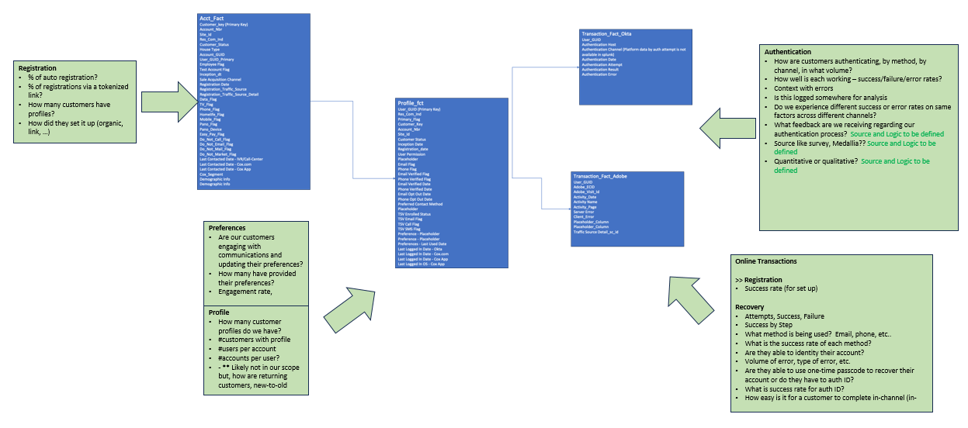
Summary of the CIAM Data Model for BI Reporting

Slide 7
Thank You

Slide 8
COX - CIAM Data Engg and BI Reporting - Overview
ENGAGEMENT OVERVIEW
Project Vision
Enable Customer Authentication & Track Activity
Data Integration & Transformation
Create Data Staging Layer From Multiple Data Sources
Tableau Based BI Dashboards
Create BI Dashboards
Every customer is enabled to authenticate
Every customer is able to authenticate
Enable View into customer activity & transactions
Access enabled for the AWS DB/Athena
Design & Align on the Data Framework and Models
Integrate Data Queries from Multiple Data Tales
Data and business logic validation
Design ETL Process for the staging layer
Access enabled for the AWS DB/Athena
Design & Align on the BI Framework and Wireframes
Integrate BI with the Data Staging Layer
Validate Data Transformation based on Business Logic
Design Tableau based Dashboards for Business
CURRENT PROGRESS (As Per Original Planned Timeline)
DATA MODELS/FRAMEWORK
BI DASHBOARDS
Overall Project Status
Account & Profile –
Extraction of Fact Tables – Completed
Cox Validation of Fact Tables – Ongoing
Octa/Adobe Activity Fact Tables –
Extraction of Fact Tables – Completed
Cox Validation of Fact Tables – Ongoing
Account & Profile Fact Tables Wireframe – Completed
Account & Profile Fact Tables Dashboard – WIP
Octa/Adobe Activity Fact Tables Dashboards – WIP
Tableau Access & S3 connectivity – WIP ( Manual approach to connect S3 but session disconnect in 8 Hrs.)
AWS complete data set access for eClerx Team – Pending
Excel operation limitation in Cox environment – Delay in data validation
Limited access to Cox S3 data tables making data validation a longer process
Changes to the Lookup Rules post validation leads to iterations on fact tables increasing the timelines
Tableau Access & S3 connectivity - Required SW Installed however the Secured Access Key is Pending
Dependency on the fact tables validation & completion
Project Risk
& Challenges
Ongoing Data & Business Logic Enhancements

Slide 9
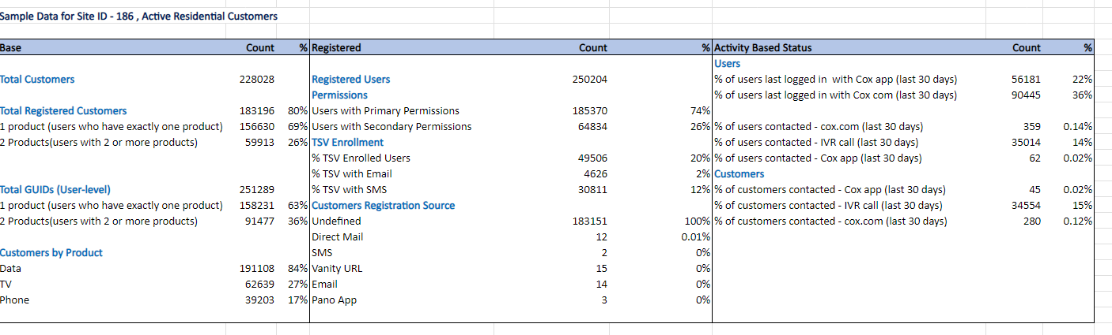
Ongoing Data/Business Logic Validation Summary View
Data validation is in progress

Slide 10
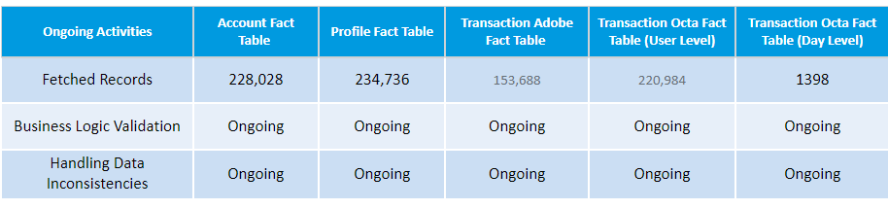
Ongoing Data/Business Logic Validation – Summary & Risks
The Data Engg and BI Teams is consistently working with support from the Cox Teams to continuously enhance the KPIs and the associated data inconsistencies or business logic which is consuming additional time/efforts for the data models and one such recent example is below
Impact on Timelines - Data Inconsistencies & Validation Examples
For some customers we are getting multiple registration dates which should be not the case so we resolved using the earliest registration date
In profile_fact tables we have data inconsistency on primary_user_flag. Logically, we should have one customer has only one primary_flag=“Y” but we are getting two primary flag as Y
For some tables, the columns/attributes are missing for the calculated columns and the business logic for the same needs to be validated
Changes to the business logic as above leads to rework from the team for data retrieval, validation and alignment

Slide 11
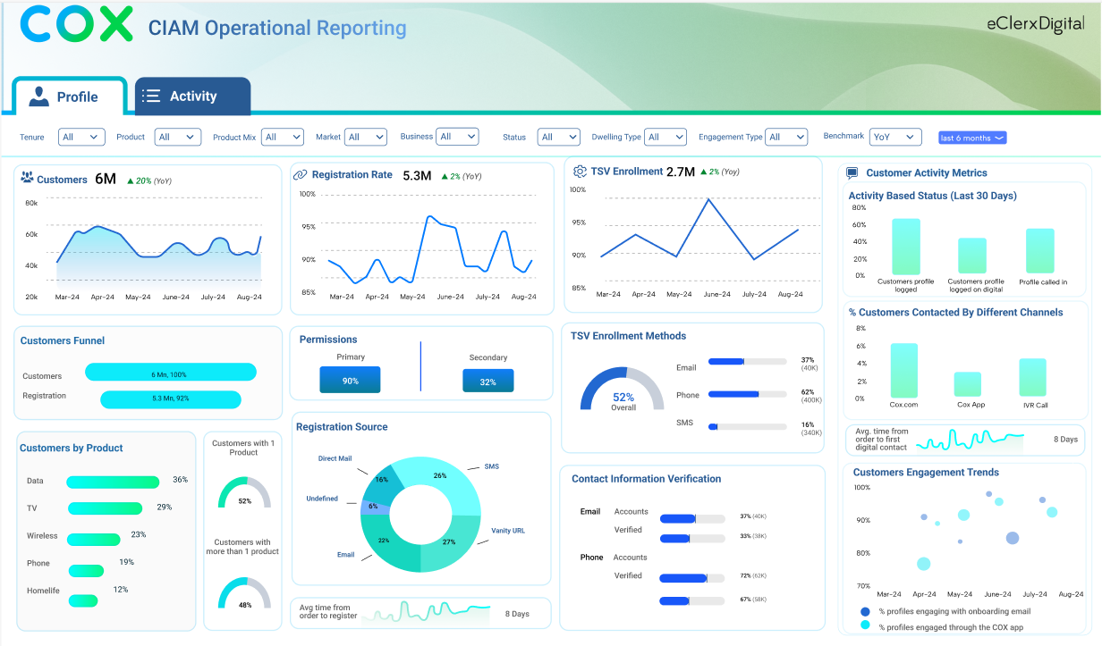
Dashboard Wireframe – Profile & Activity View (1)

Slide 12
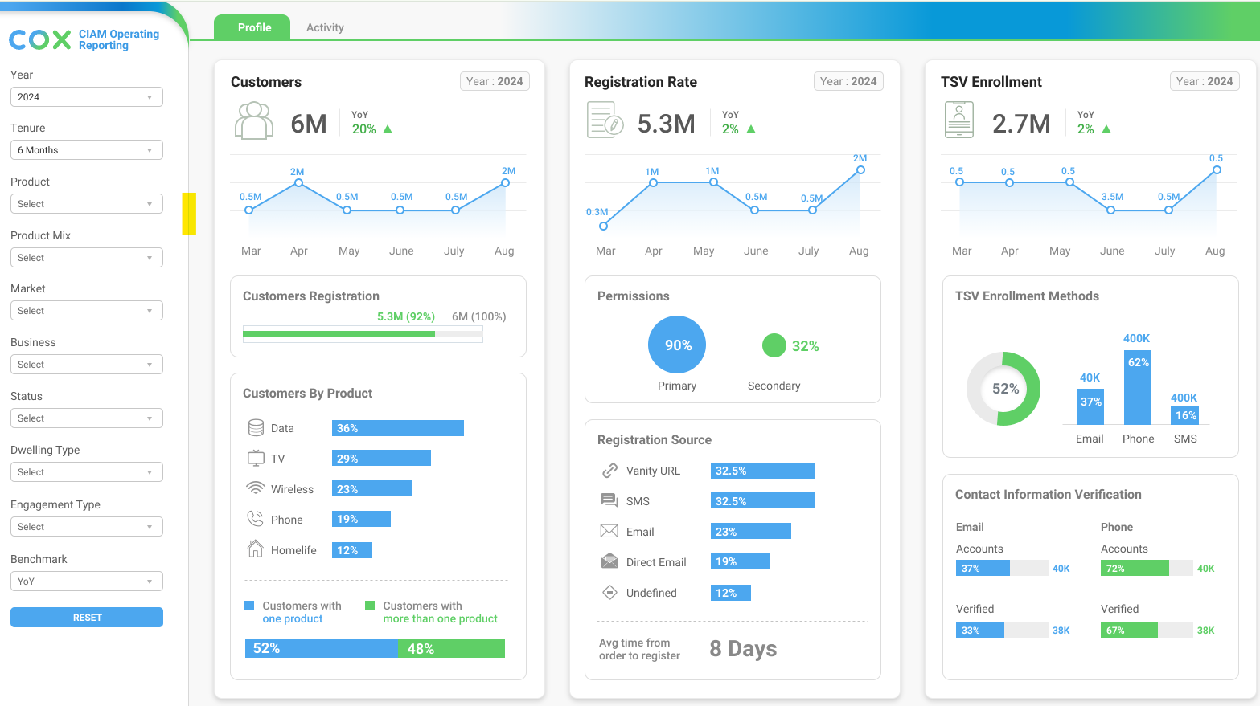
Dashboard Wireframe – Profile & Activity View (2)

Slide 13
Original Project Plan
Activities |  | 12-Aug | 19-Aug | 26-Aug | 2-Sep | 9-Sep | 16-Sep | 23-Sep | 30-Sep | 7-Oct | 14-Oct | 21-Oct | 28-Oct | 4-Nov
Engineering | Individual Accesses & Azure AVD set up
 | Discovery & Requirement Gathering
 | Accesses and Environment Setup (AWS)
 | Build Data Framework
 | Data Validation
 | Data Transformation Flow (ETL)
 | Scheduling and Automation
 | Monitoring
Visualization | Business Goals & Data Sample
 | Design Templates
 | Stakeholder Review
 | Development
 | Validation
 | Stakeholder Review
 | Deployment & Support

Slide 14
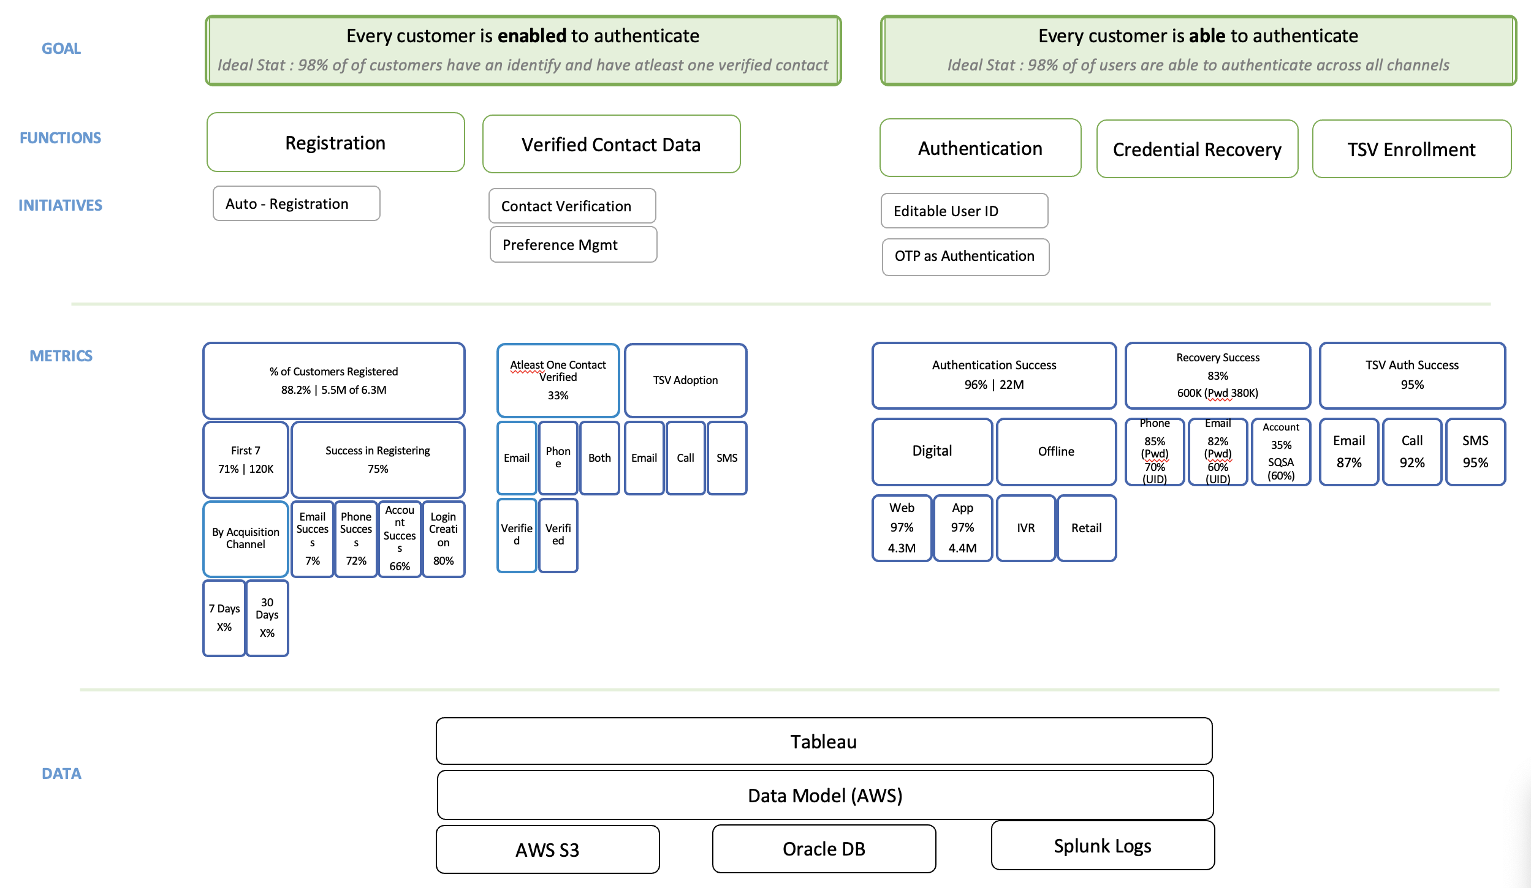
CIAM - Functions, Initiatives and Metrics Mapping (Original)

